Slide 1
UCAR Team 7 Presentation

Slide 2
Team Member Introductions
Name
Interests
Where you are from
Experience
Favorite Activity

Slide 3

Sponsoring organization
introduction
UCAR stands for the University Corporation of Atmospheric Research. They oversee the National Science Foundation's National Center for Atmospheric Research (NSF NCAR) and work with universities to further research into atmospheric sciences and earth sciences. They also participate in advocacy for the earth system sciences, and work to further education regarding those fields at all levels of education.

Slide 4
Sponsoring organization
mission & vision
Mission: We develop state-of-the-art educational experiences that connect NSF NCAR & UCAR science to a broad community of learners, creating pathways towards a scientifically literate society.
Vision: Engaging all learners to explore and understand our changing world.

Slide 5
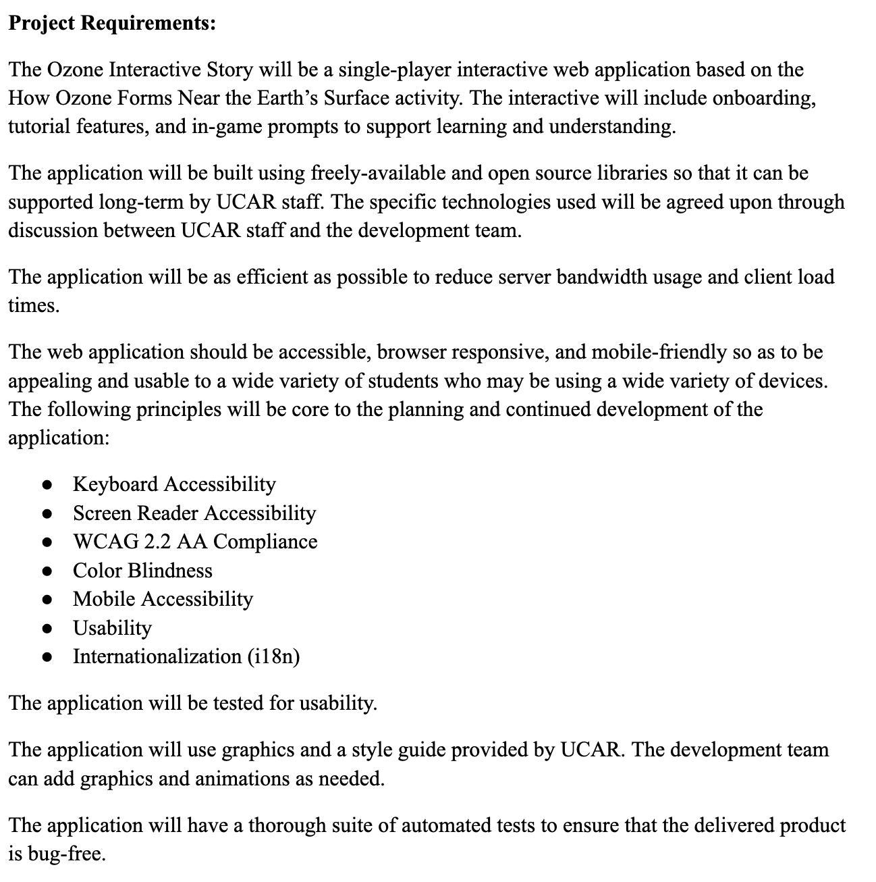
Project overview

Slide 6
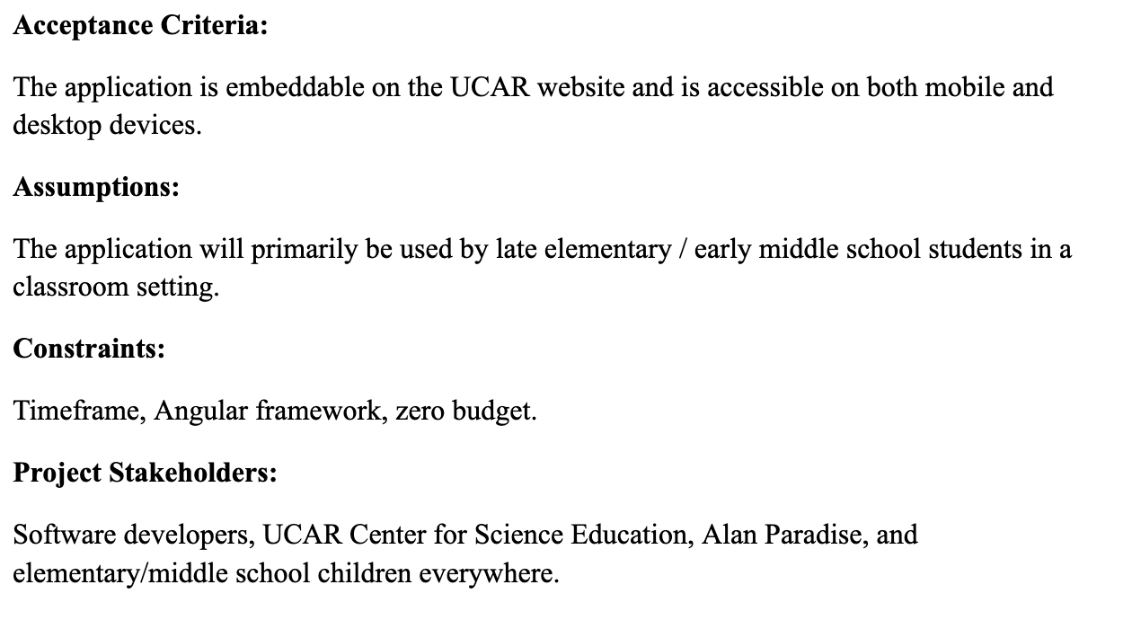
Project overview
Notes:
Linh

Slide 7
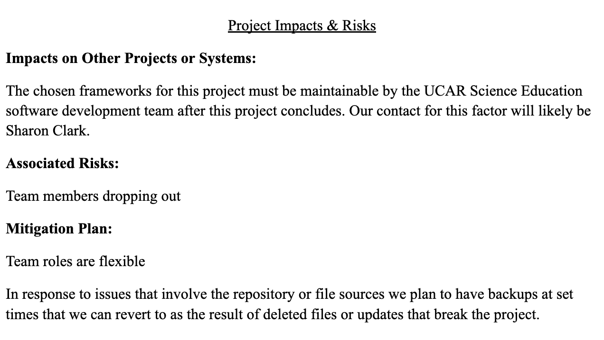
Project overview

Slide 8
The End

